Slide 1
Leaf Disease Detector
By Ashfaq Uddin Ahmed 1911848042

Slide 2
About the project
﻿
This project is based on the image classification technique. I am going to use Deep Learning for this project. We familiarized with the convolution neural network(CNN).
In the project, we are going to use one of the transfer learning technique i.e Resnet 50 as well.
I will train my model on the basis of different pictures of leaves suffering from various disease after that we will compare the model with normal leaf pictures and will check how much accuracy we are getting from it.
It is also a real-life problem-based project that can be used in agricultural purposes

Slide 3
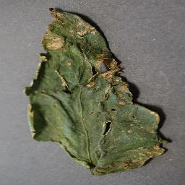
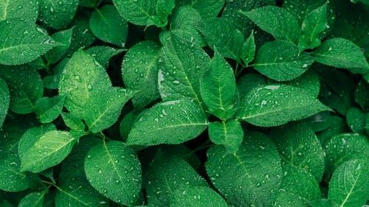
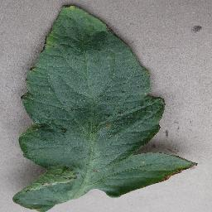
Procedure
Trained on the basis of different affected leaf.
For home use and for bigger agricultural use
CNN and Transfer Learning(TL) algorithms
Colab and Python

